Slide 1
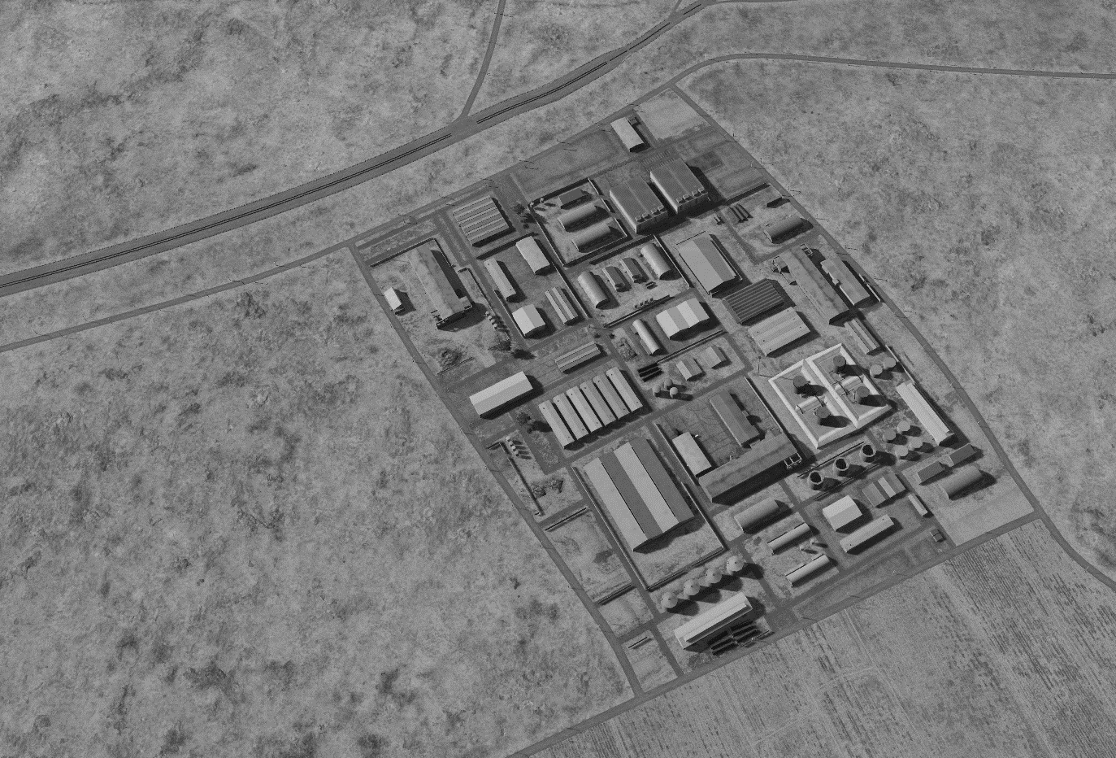
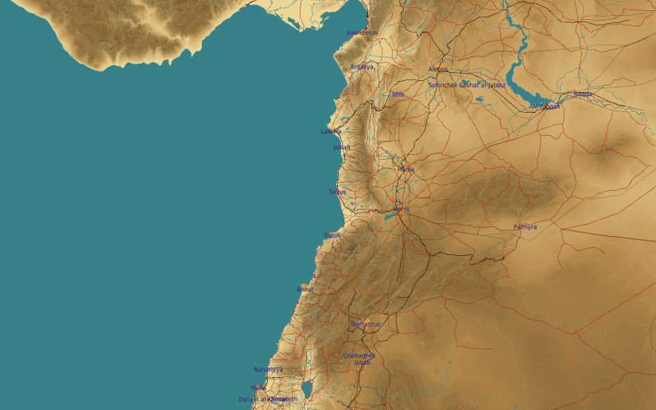
OPARTGT007 DAMASCUS NE AMMUNITION FACTORY
N
2
1
3
4
07
9
DESIRED POINT of IMPACT:
Assembly Buildings
DPI 9 - N33 37.194 E 36 29.105 / 2103ft/ 2000lb bomb
DPI 8 - N33 37.163 E 36 29.108 / 2101ft/ 2000lb bomb
DPI 7 - N33 37.172 E 36 29.075 / 2105ft/ 2000lb bomb
DPI 6 - N33 37.143 E 36 29.034 / 2100ft/ 2000lb bomb
DPI 5 - N33 37.150 E 36 29.052 / 2100ft/ 2000lb bomb
Storage Facilities
DPI 4 - N33 37.312 E 36 28.997 / 2120ft/ 500lb bomb
DPI 3 - N33 37.327 E 36 28.987 / 2130ft/ 500lb bomb
DPI 2 - N33 37.393 E 36 29.016 / 2140ft/ 500lb bomb
DPI 1 - N33 37.321 E 36 28.917 / 2139ft/ 2000lb bomb
7
8
5
6

